Slide 1
Predicting Plant Health with Neural Networks
Casey Nosiglia
BrainStation Data Science July 2022
Capstone Project
Notes:
· Hello, my name is Casey Nosiglia, and I’m a recent graduate from the BrainStation data science boot camp. I have an educational background in physics, having conducted research in material science.
· More recently, I’ve worked in patent law, helping inventors protect their IP by drafting patent applications in several different technology fields.
· While I learned a lot about new technologies working in patent law, I wanted to transition to data science in order to get back to my quantitative roots.
· Today I’ll be presenting a brief summary of my capstone project, “Predicting Plant Health using Neural Networks”.

Slide 2
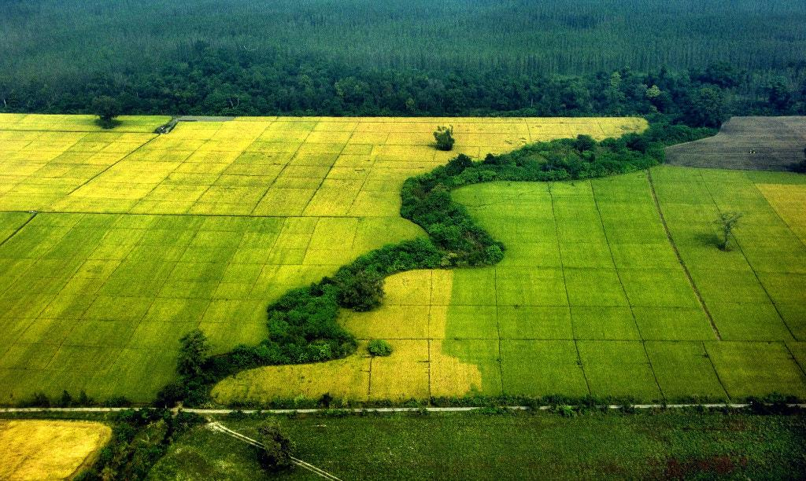
The Problem: Crop Contamination for Smallholders
Loss in crop yield due to pest and pathogen (P & P) contamination commonly ranges from 17% - 30% for common crops (e.g., wheat, rice, maize, potato, soybean).
Notes:
· The agriculture industry is highly dependent on crop health, which may be affected by pests and pathogens; in particular, loss in crop yield from P&P contamination ranges from 17-30% for common crops

Slide 3
The Problem: Crop Contamination for Smallholders
Loss in crop yield due to pest and pathogen (P & P) contamination commonly ranges from 17% - 30% for common crops (e.g., wheat, rice, maize, potato, soybean).
Smallholder farms produce 32% of the world’s food; many in developing nations.
Notes:
· While large factory farms may have the resources to identify unfamiliar P&P contamination, smallholder farms (defined as farms under 2 hectares) may not; this is a problem, as smallholder farms produce 32% of the world’s food, with many in developing nations.

Slide 4
The Problem: Crop Contamination for Smallholders
Loss in crop yield due to pest and pathogen (P & P) contamination commonly ranges from 17% - 30% for common crops (e.g., wheat, rice, maize, potato, soybean).
Smallholder farms produce 32% of the world’s food; many in developing nations.
84% of the world’s population have smartphones, with projections to increase -> opportunity for expanding crop disease monitoring.
_____________________________________________________________________________________________________
Sources: https://www.fao.org/news/story/en/item/1395127/icode/, https://www.nature.com/articles/s41559-018-0793-y,
https://www.bankmycell.com/blog/how-many-phones-are-in-the-world
Notes:
· However, due to the rapid growth of smartphone technology, 84% of the world’s population now have smartphone access, creating an opportunity for smallholder farmers to easily identify unfamiliar disease in their own crops using their smartphone cameras.

Slide 5
Business Question
Can a computer correctly identify healthy/diseased (amongst all species)?
Can a computer correctly identify the disease type within a given species (e.g., tomato)?
Notes:
· Given the potential of empowering smallholder farmers to diagnose their own crops with smartphone technology, I asked the following two business questions: first, can a computer correctly identify images of healthy and diseased leaves among several plant species? And second, can a computer correctly identify the disease type within a given species (such as tomatoes)?

Slide 6
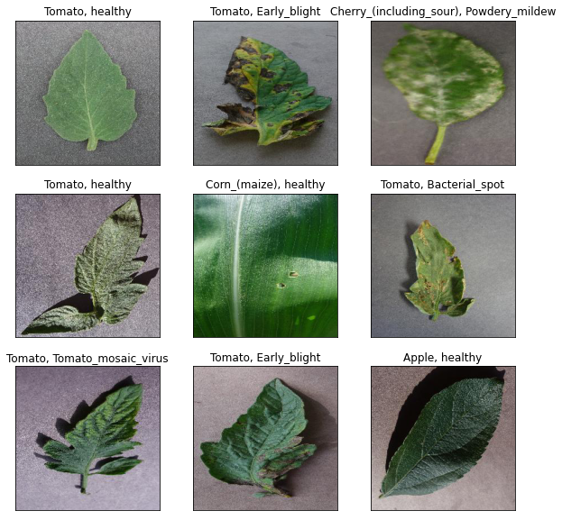
Data Sourcing
Plant Disease Dataset: https://www.kaggle.com/datasets/saroz014/plant-disease
54.3k images with 14 plant species and 26 diseases represented.
Notes:
· In order to answer my business questions, I used the plant disease dataset from Kaggle, which includes highly curated images of plant leaves from the opensource PlantVillage project.
· In this dataset, there are 54.3k plant leaf images, with 14 different plant species and 26 plant diseases represented.

Slide 7
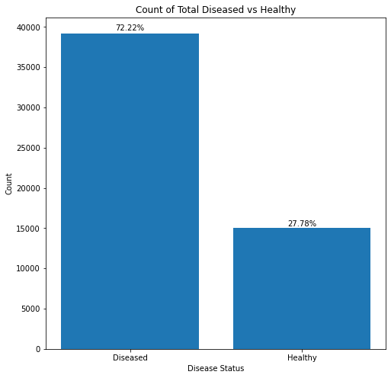
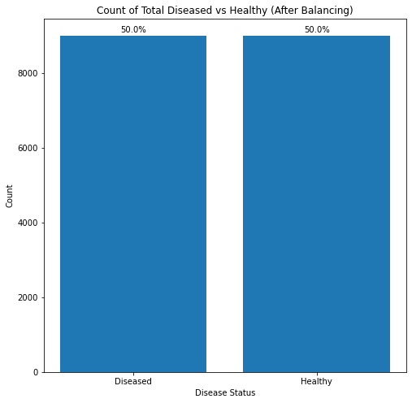
Class Balancing - Diseased vs. Healthy
Notes:
· As part of my data wrangling, for the diseased vs healthy classification problem, I downsampled each class to 9000 images each, so that the classes would be equally represented.

Slide 8
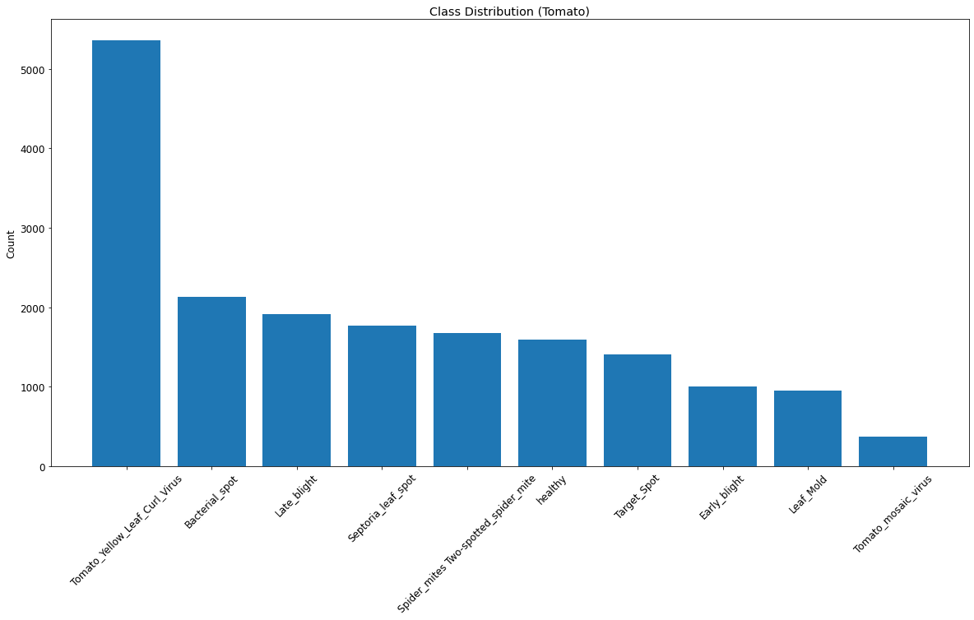
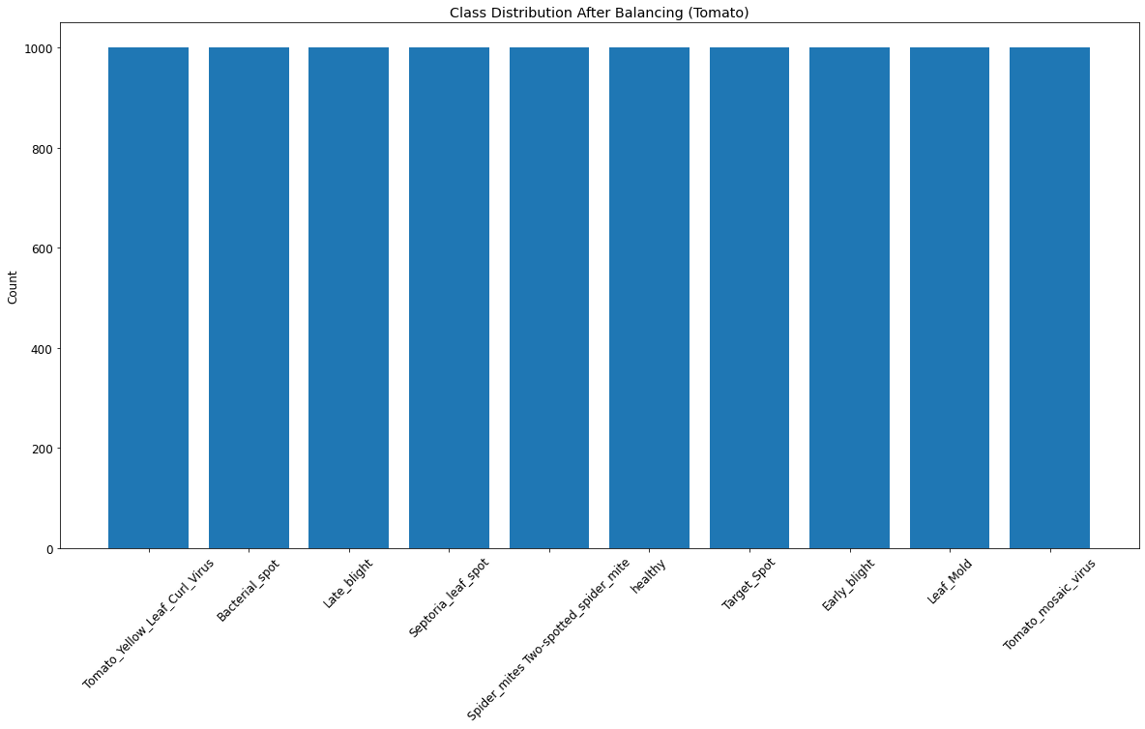
Class Balancing - Tomatoes
Notes:
· Similarly, for the tomato classes (including healthy plus 9 different diseases), I up and downsampled so that each tomato class would have 1000 images each.

Slide 9
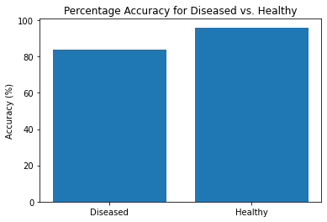
Modeling and Findings: Diseased vs. Healthy
Convolutional Neural Network (CNN) with normalization and data augmentation.
Notes:
· In order to classify diseased vs. healthy, I used convolutional neural networks, and I normalized and augmented my data to minimize overlearning the training data

Slide 10
Modeling and Findings: Diseased vs. Healthy
Convolutional Neural Network (CNN) with normalization and data augmentation.
Overall classification accuracy: 90%
Notes:
· After optimizing my parameters, my best model was able to classify the images correctly 90% of the time, correctly identifying healthy images 96% of the time and correctly identifying diseased images 84% of the time.

Slide 11
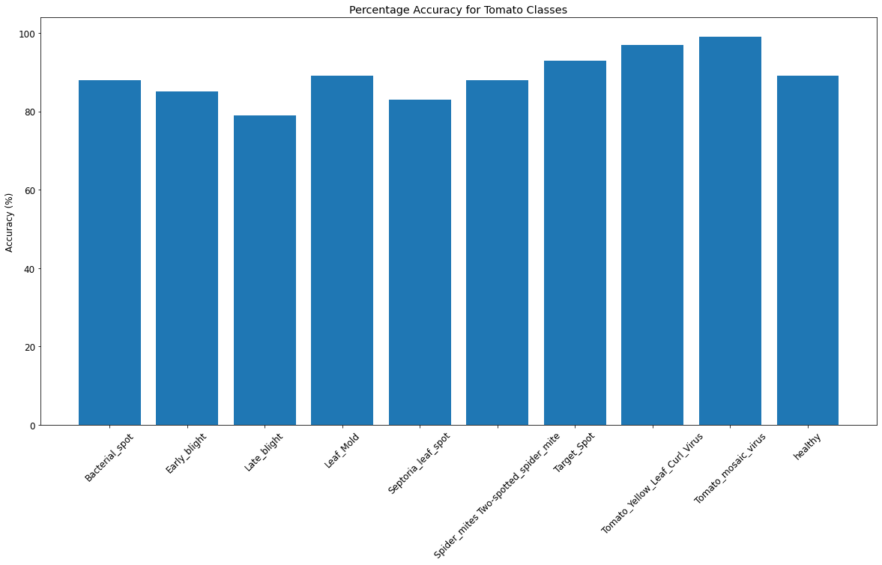
Modeling and Findings: Tomato
ResNet50 with normalization and data augmentation.
Notes:
· For identifying the different tomato classes, I used an advanced CNN called ResNet50, and adapted it to my classification problem.

Slide 12
Modeling and Findings: Tomato
ResNet50 with normalization and data augmentation.
Overall classification accuracy: 89%
Notes:
· After optimization, my model was able to classify the images correctly 89% of the time, with the accuracies for each class shown on the right.

Slide 13
Ideas for the Future
Improve accuracy of both models.
Extend to classify all classes (12 healthy + 26 diseased).
Build new model for classification of diseases of new species.
Notes:
· In order to improve this project for the future, I’d like to first improve the classification accuracy of both models, and then try the full classification problem for the 12 healthy and 26 diseased classes, and finally build a new model trained on a broader dataset for classification of a wider variety of diseases.

Slide 14
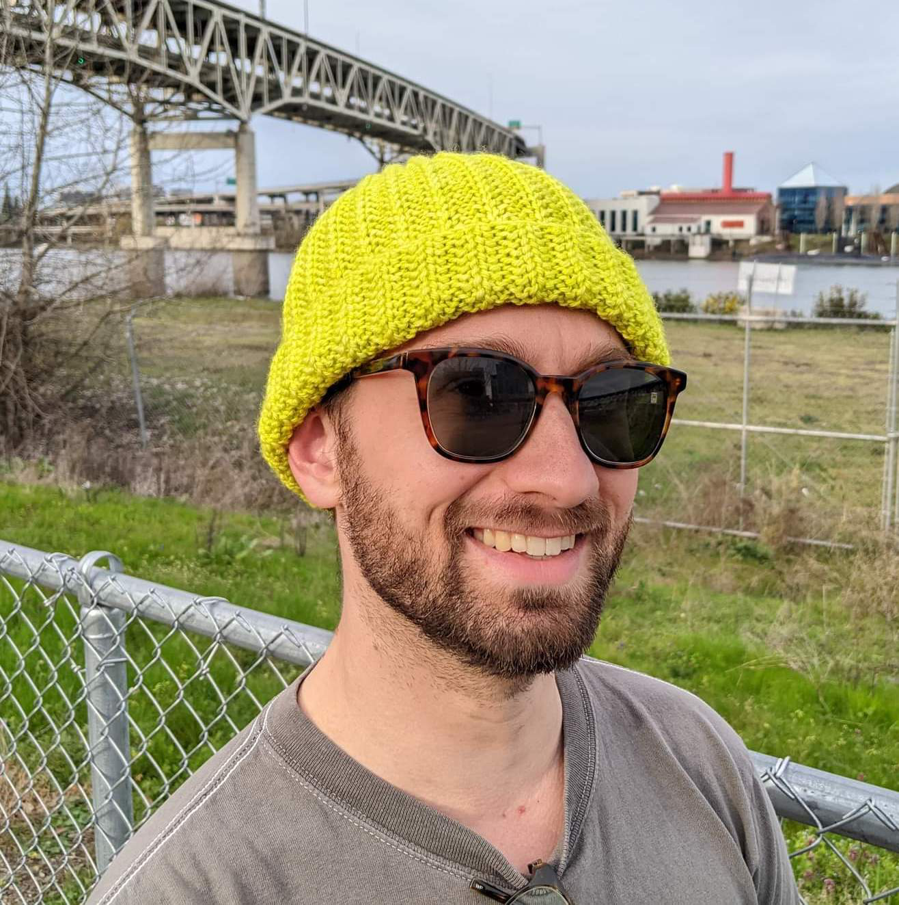
Thank you! Contact
Special thanks to the Data Science instructors and my fellow classmates!
caseynosiglia@gmail.com
https://www.linkedin.com/in/casey-nosiglia
Notes:
· Thank you for listening, and I want to give a special thanks to the Data Science instructors and my fellow classmates, and if you’d like to get in touch for any reason, my contact info is on the right.

